Slide 1
Monitoring & Alerting
08-10-2024
{Dev}School Java Edition
Presenters: Mihaela Dragu

Slide 2
Main Topics
Why monitoring
What is monitoring
What do we use it for
Different tooling for different purposes

Slide 3
What it comes to mind when saying monitoring?
Measure network
Response times
Logs
Status codes
Failures
Events
Taking action

Slide 4
Why do we monitor?
We have to know how the system behaves
Do I need to improve my system?
What is the effect of my improvement?
Alerting: System is broken!
Building dashboards - how is my system doing real time?
Comparison over time - do we need more resources?

Slide 5
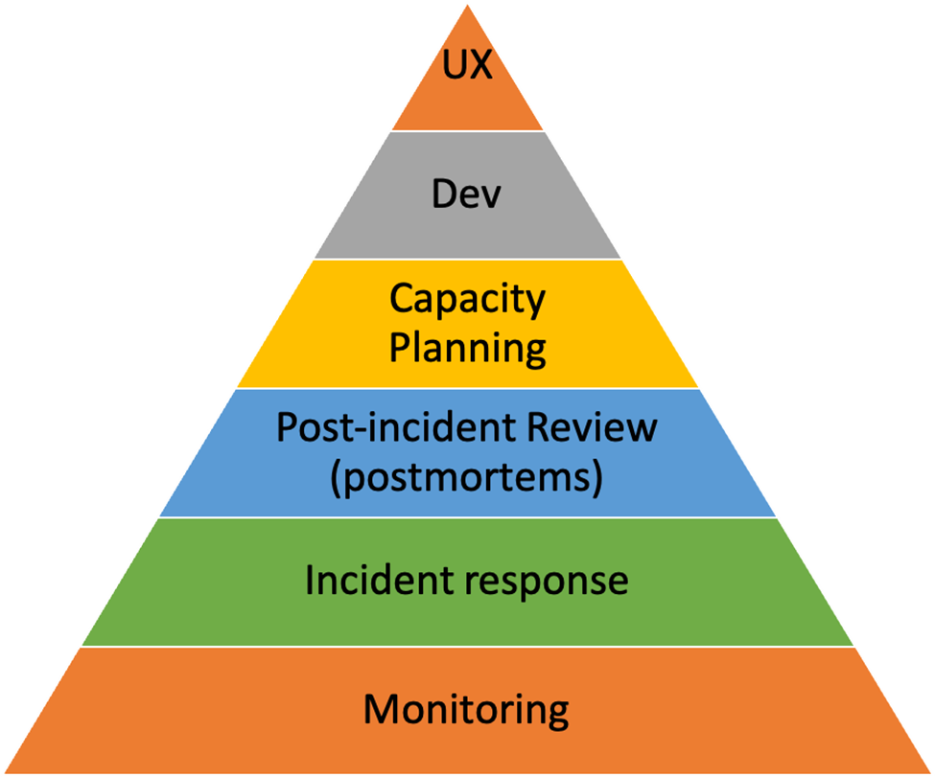
Notes:
A Site Reliability Engineering (SRE) pyramid, also known as the 'Dickerson pyramid,' provides a set of principles that an organization can use to define and improve reliability to promote engineering excellence.
In order to have a stable product you need to have a stable base.
The way we can interpret this is:
If you have no monitoring, how will you do incident response? If you don’t handle incidents well, how are you doing postmortems and so on.
Especially for the main payment channels or authentication/ consent the availability % is very important.

Slide 6










Data Collection
Data Storage
Alerting
AlertManager
IAT
Analysis & Vizualisation
Reporting
Notes:
We have 3 main parts:
Data collection, data storage, alerting;

Slide 7
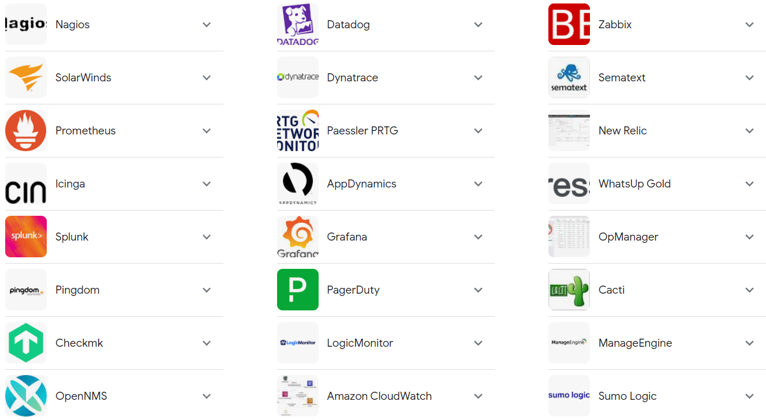
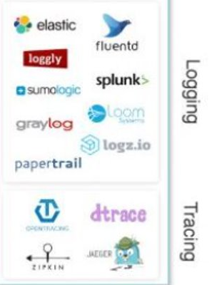

Slide 8
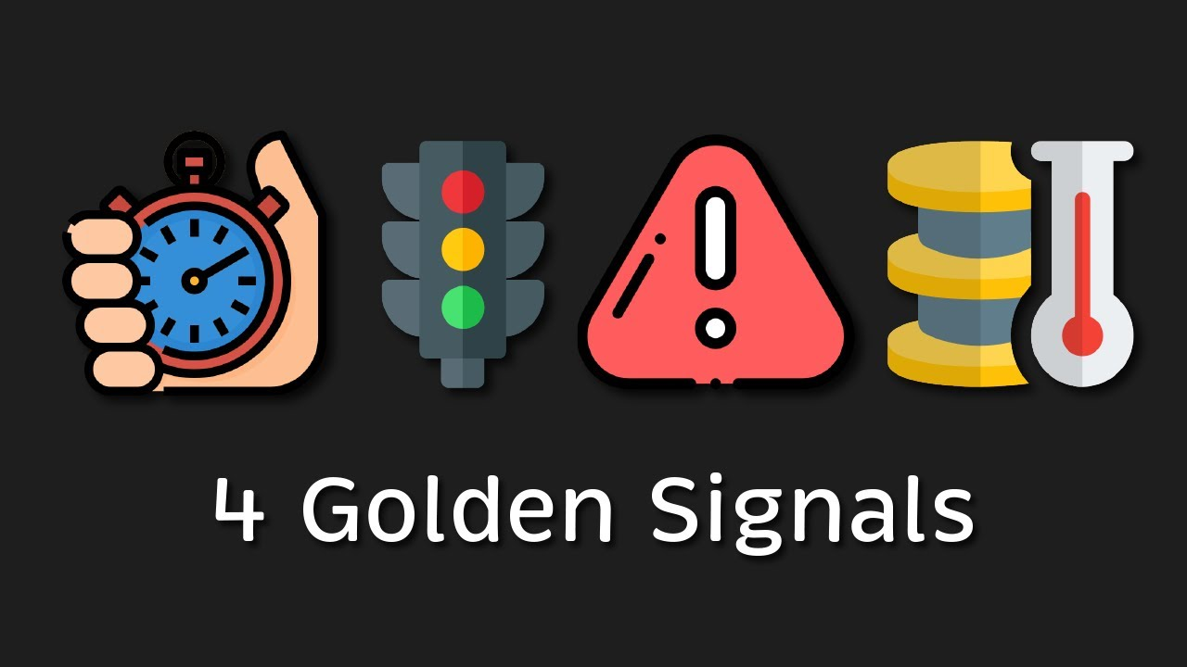
Notes:
Latency: how long to handle a request
Traffic: how many requests
Errors: which errors with which frequency
Saturation: how full is my system?
Start with above and then if you see the need expand with other monitoring questions (based on business needs or other events etc). The focus ofc is on growing the product and delivering more so you don’t want to spend also too much time on metrics that no one will use after creation time.

Slide 9
How do we get the metrics then?

Slide 10
Exposing metrics
We are using a framework inside ING, so there are Prometheus client side libraries already included so basically we can toggle them on or some are even on by default so the application is already exposing some metrics.
If you are not using this frameworks then you need to include the libraries to collect this information.
The other agents like Collectd, Node Exporter, are part of the infrastructure and can be installed on the machines.
Notes:
There is no 1 size fits all solution, as the developer / operations you need to see what are your needs and based on that see what options are available to use.

Slide 11
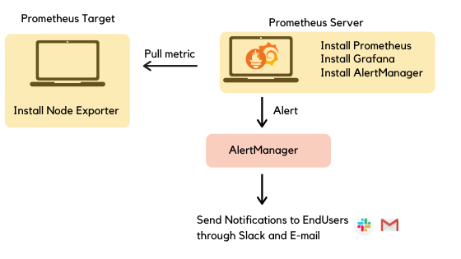
Prometheus Example Overview

Slide 12
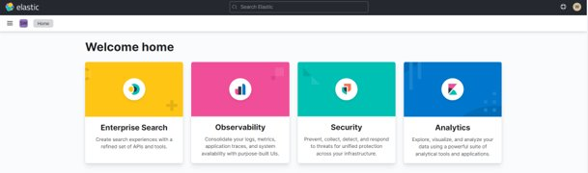
Elastic
We use a service delivered by our colleagues built around the Elastic stack solution.
The Elastic Stack (White Box Monitoring) provides us with:
Onboarding request
Alerting request
Customizable logs and metrics
Kibana dedicated spaces for the teams in Elastic Clusters
Kibana access to the data via Discover, Vizualize and Dashbaords
Kibana saved objects, saved searches
Reports

Slide 13
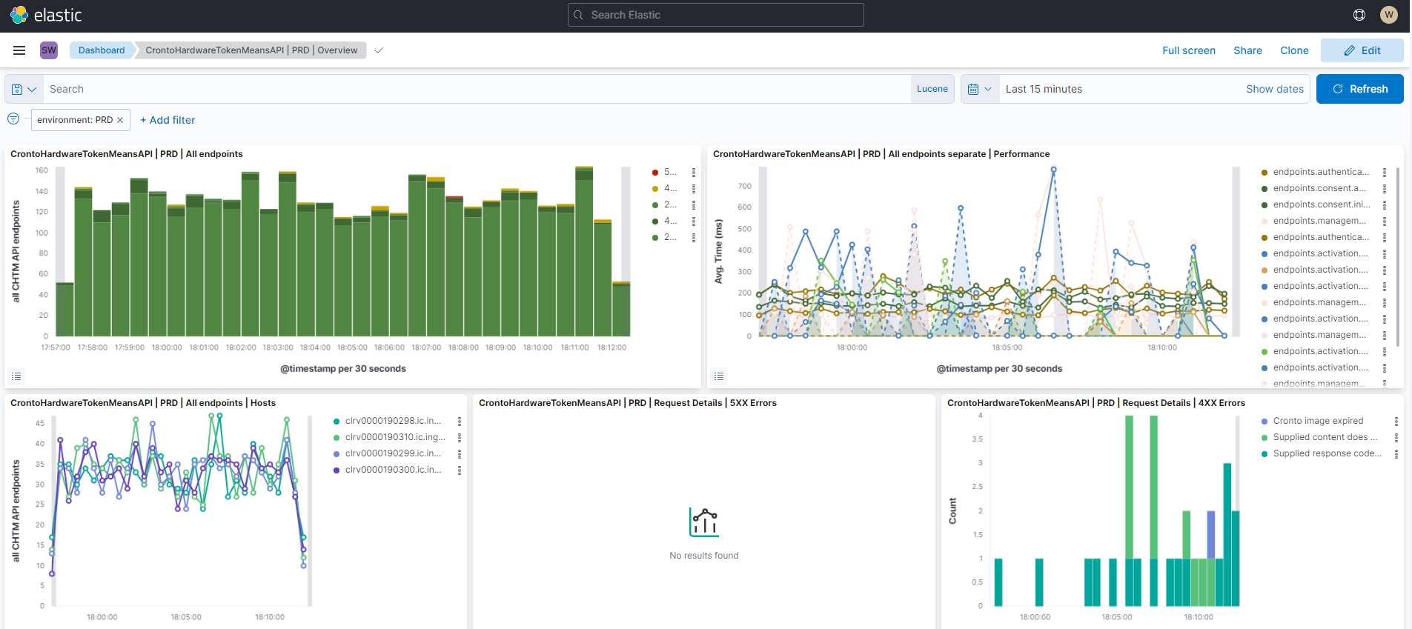

Slide 14
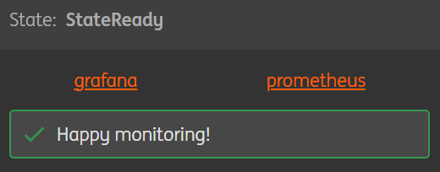
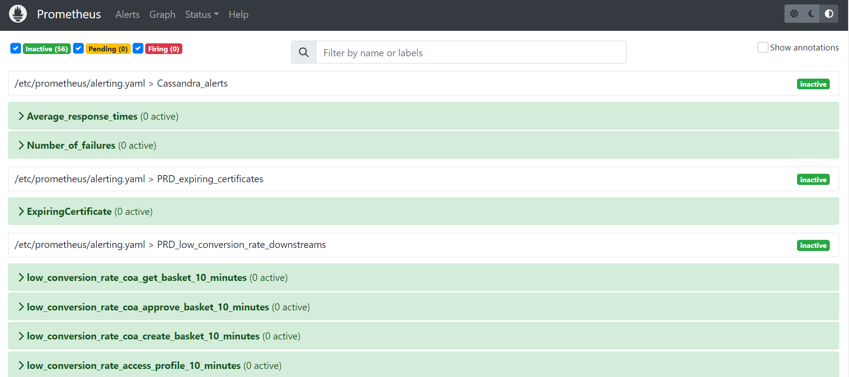
How we do it?

Slide 15
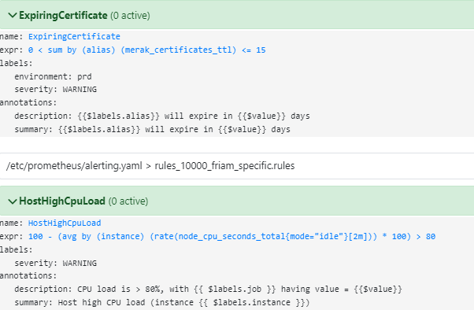
Prometheus
Notes:
Show: test your querries in Prometheus and once they are ready, you see results and all is ok you can create dashboards in Grafana and have a more visual way of monitoring (make it pretty and readible);
In prometheus you can also see the status of your instances;

Slide 16
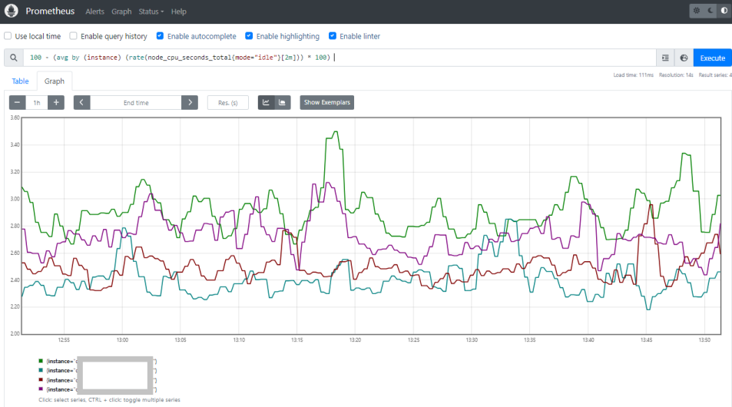

Prometheus Query Language

Slide 17
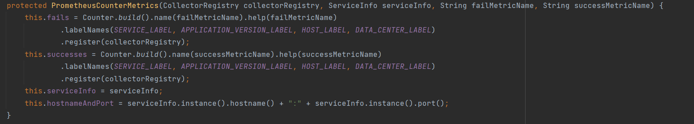
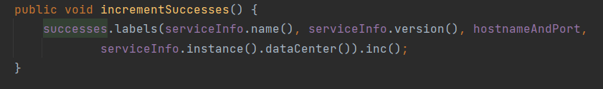
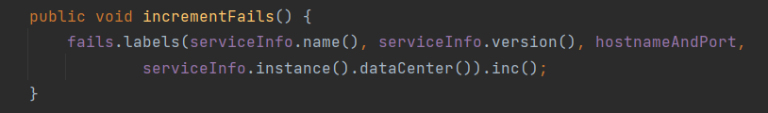
Prometheus custom metrics
Custom metrics are application-level or business-related tailored metrics,
as opposed to the ones that come directly out-of-the-box from monitoring systems

Slide 18
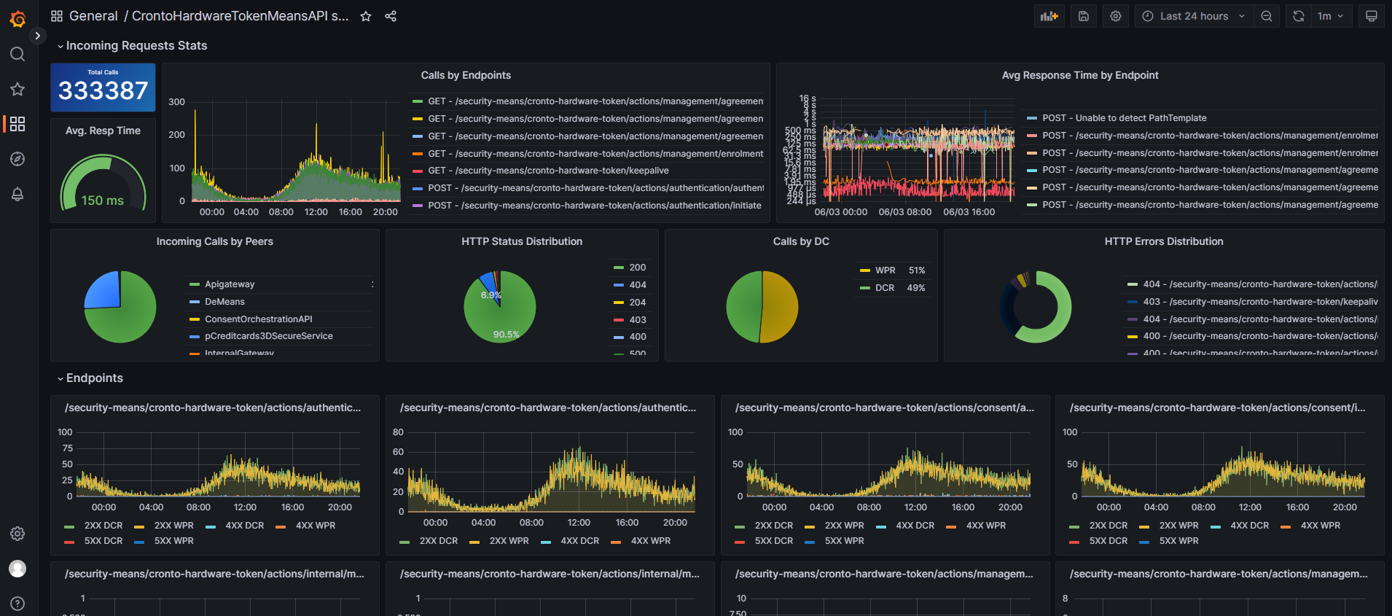
Dashboards example

Slide 19
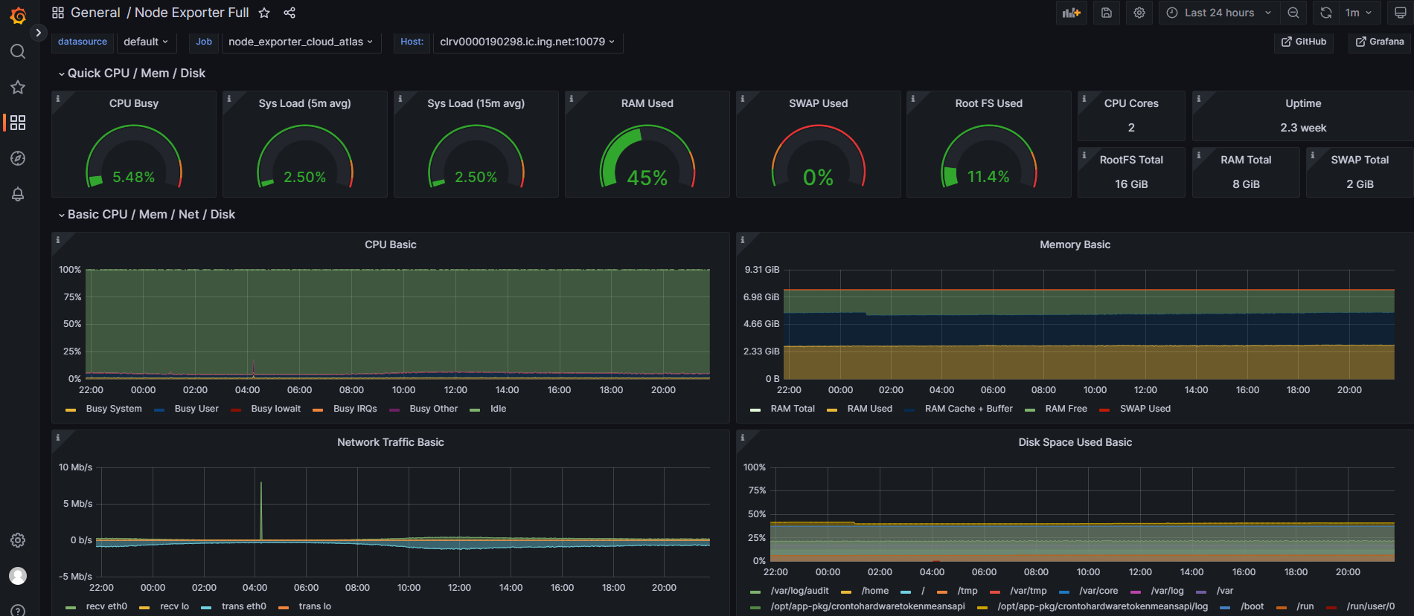
System Information on Node Exporter

Slide 20
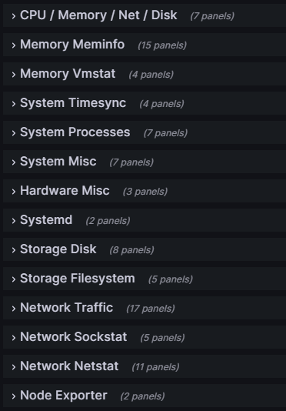
System Information on Node Exporter

Slide 21
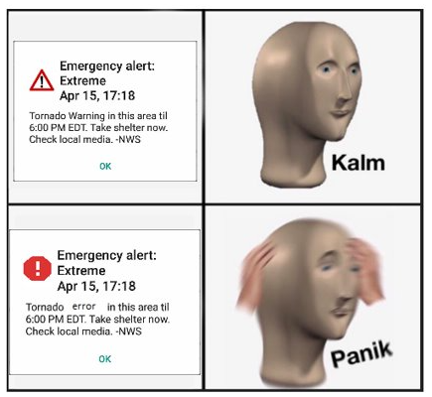
Dashboards won't wake you up at night, alerting will

Slide 22
Types of Alerting
Informational
Must act in advance
Critical
Advisory information
Increase in disk/CPU usage; certificates expiry
Instance down; Low conversion Rate

Slide 23

Alert fatigue
Notes:
Be careful of fatigue alerts! Too many emails or even sms will lead in the end to ignoring and missing important ones; so we need to find just the right balance.

Slide 24
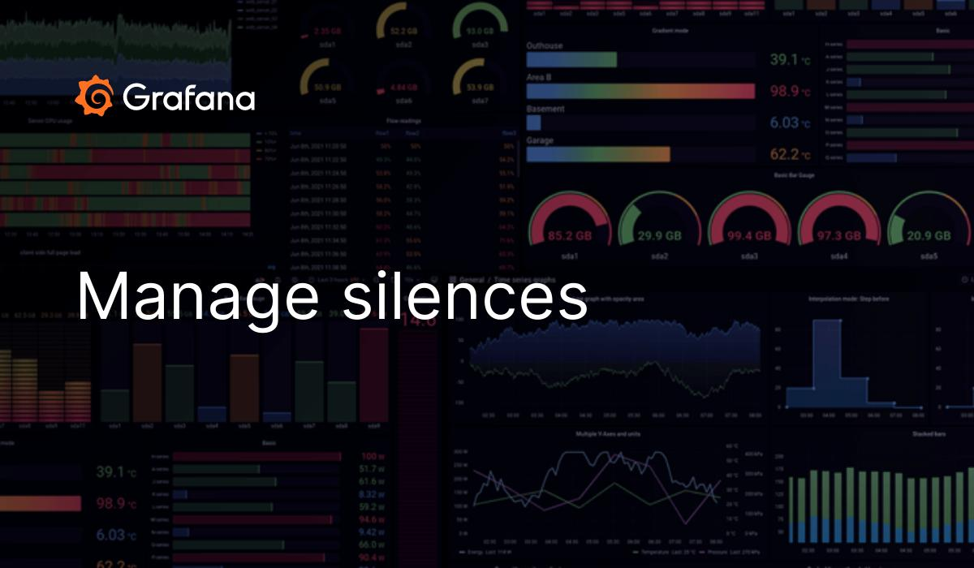
Silence
Have granularity where possible so we can silence only certain alerts
Don't forget to lift up the silence once you completed your fix/task
This option can be used already with AlertManager, IAT etc
Notes:
Silence is also important!
There is a danger when we silence too broad: if we work on something and silence the alerts so we wont alert everyone, but in that exact time something else is breaking we will not be alerted

Slide 25
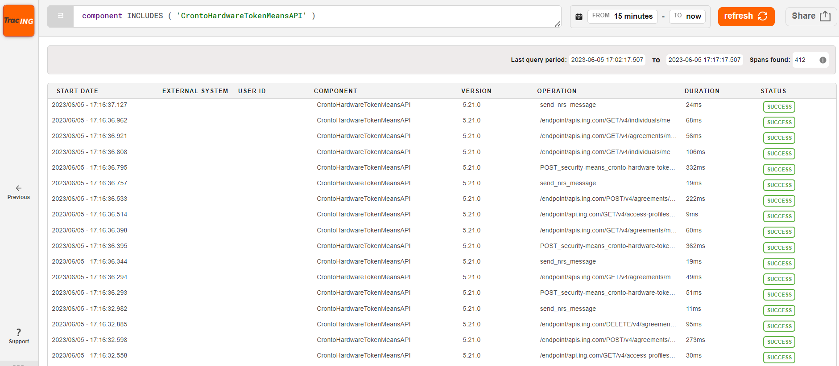
Tracing
In software engineering, tracing involves a specialized use of logging to record information about a program's execution.
Notes:
A week point of tracing: you need to have many people on board to make it visible
On the plus side, if as an organization is a standard, it will be easy to follow a request, spot some error and start investigation;

Slide 26
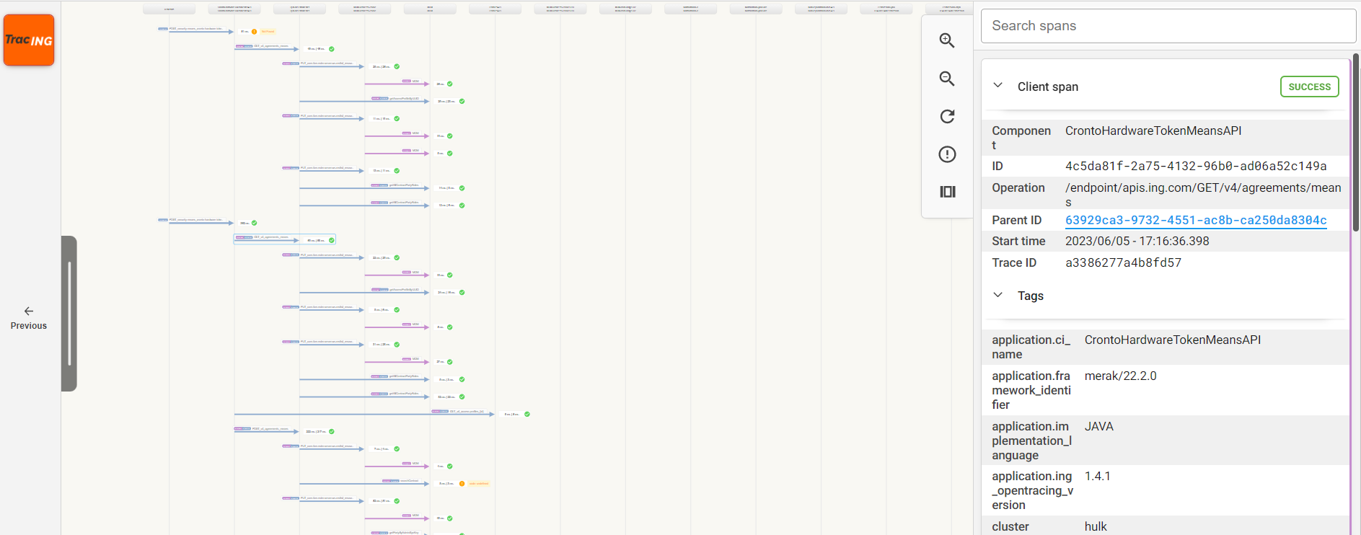
Example of multiple services traced of a request

Slide 27
Who Monitors the Monitoring
The Reliability Team have a Prometheus instance that monitors the Prometheus stack that the end teams / squads are using;
If the stack goes down, the team detects it and fix it;

Slide 28
Qualities of Metrics, Monitoring and Alerting Systems
Independent from the other infrastructure
Reliable
Strategy for mantaining historical data
Able to correlate information from different sources
Notes:
The monitoring system needs to be independently accessible. Airm to keep to minimal the performance impact of tracking and to increase the reliability of the monitoring in the event of system problems
2. Dropped metrics, service outages, and unreliable alerting can all have an immediate harmful impact on your ability to manage your infrastructure effectively. This applies not only to the core software reliability, but also to the configuration you enable, since mistakes like inaccurate alerting can lead to a loss of trust in the system.
3. ideally, all information would be retained indefinitely in its original granularity, cost and resource constraints can sometimes make it necessary to store older data at a reduced resolution.
4. Administrators should be able to glue together information from disparate parts of their systems at will to understand potential interactions and overall status across the entire infrastructure. Ensuring that time synchronization is configured across your systems is a prerequisite to being able to correlate data from different systems reliably.

Slide 29
References
https://www.geeksforgeeks.org/what-is-elastic-stack-and-elasticsearch/
https://sre.google/sre-book/monitoring-distributed-systems/
https://www.digitalocean.com/community/tutorials/an-introduction-to-metrics-monitoring-and-alerting
https://prometheus.io/
https://www.elastic.co/

Slide 30








Thank you!
ing.com
@ING_News
LinkedIn.com/company/ING
SlideShare.net/ING
Medium.com/ing-blog
ingwb.com
Facebook.com/ING
YouTube.com/ING
Flickr.com/INGGroup

